Slide 1
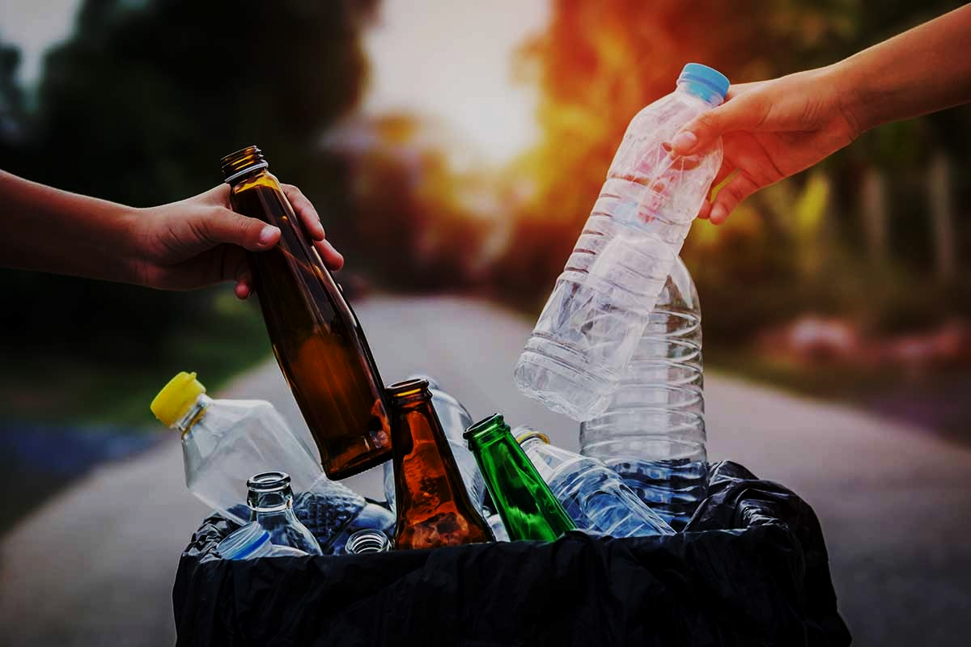
SQUANDER
CAPSTONE PROJECT
- FALL 2022
PROF HENRY WONG
Aakansha Agarwala
Austin Blaise
Nicholas Wong
Rajat Nagavkar
Suryadeep Nallana

Slide 2












AGENDA
Team Members
Product Backlog
Project Overview
Sprint Backlog
Personas
Retrospective
Technologies
Future Sprint
Design Architecture
Project Demo
Sprint Overview
Conclusion

Slide 3

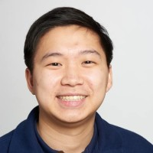
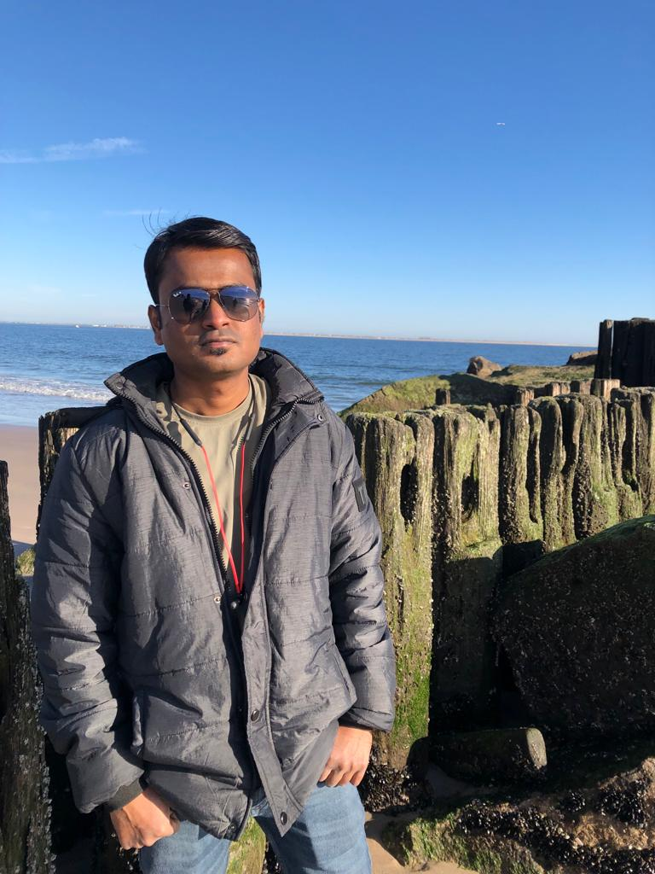
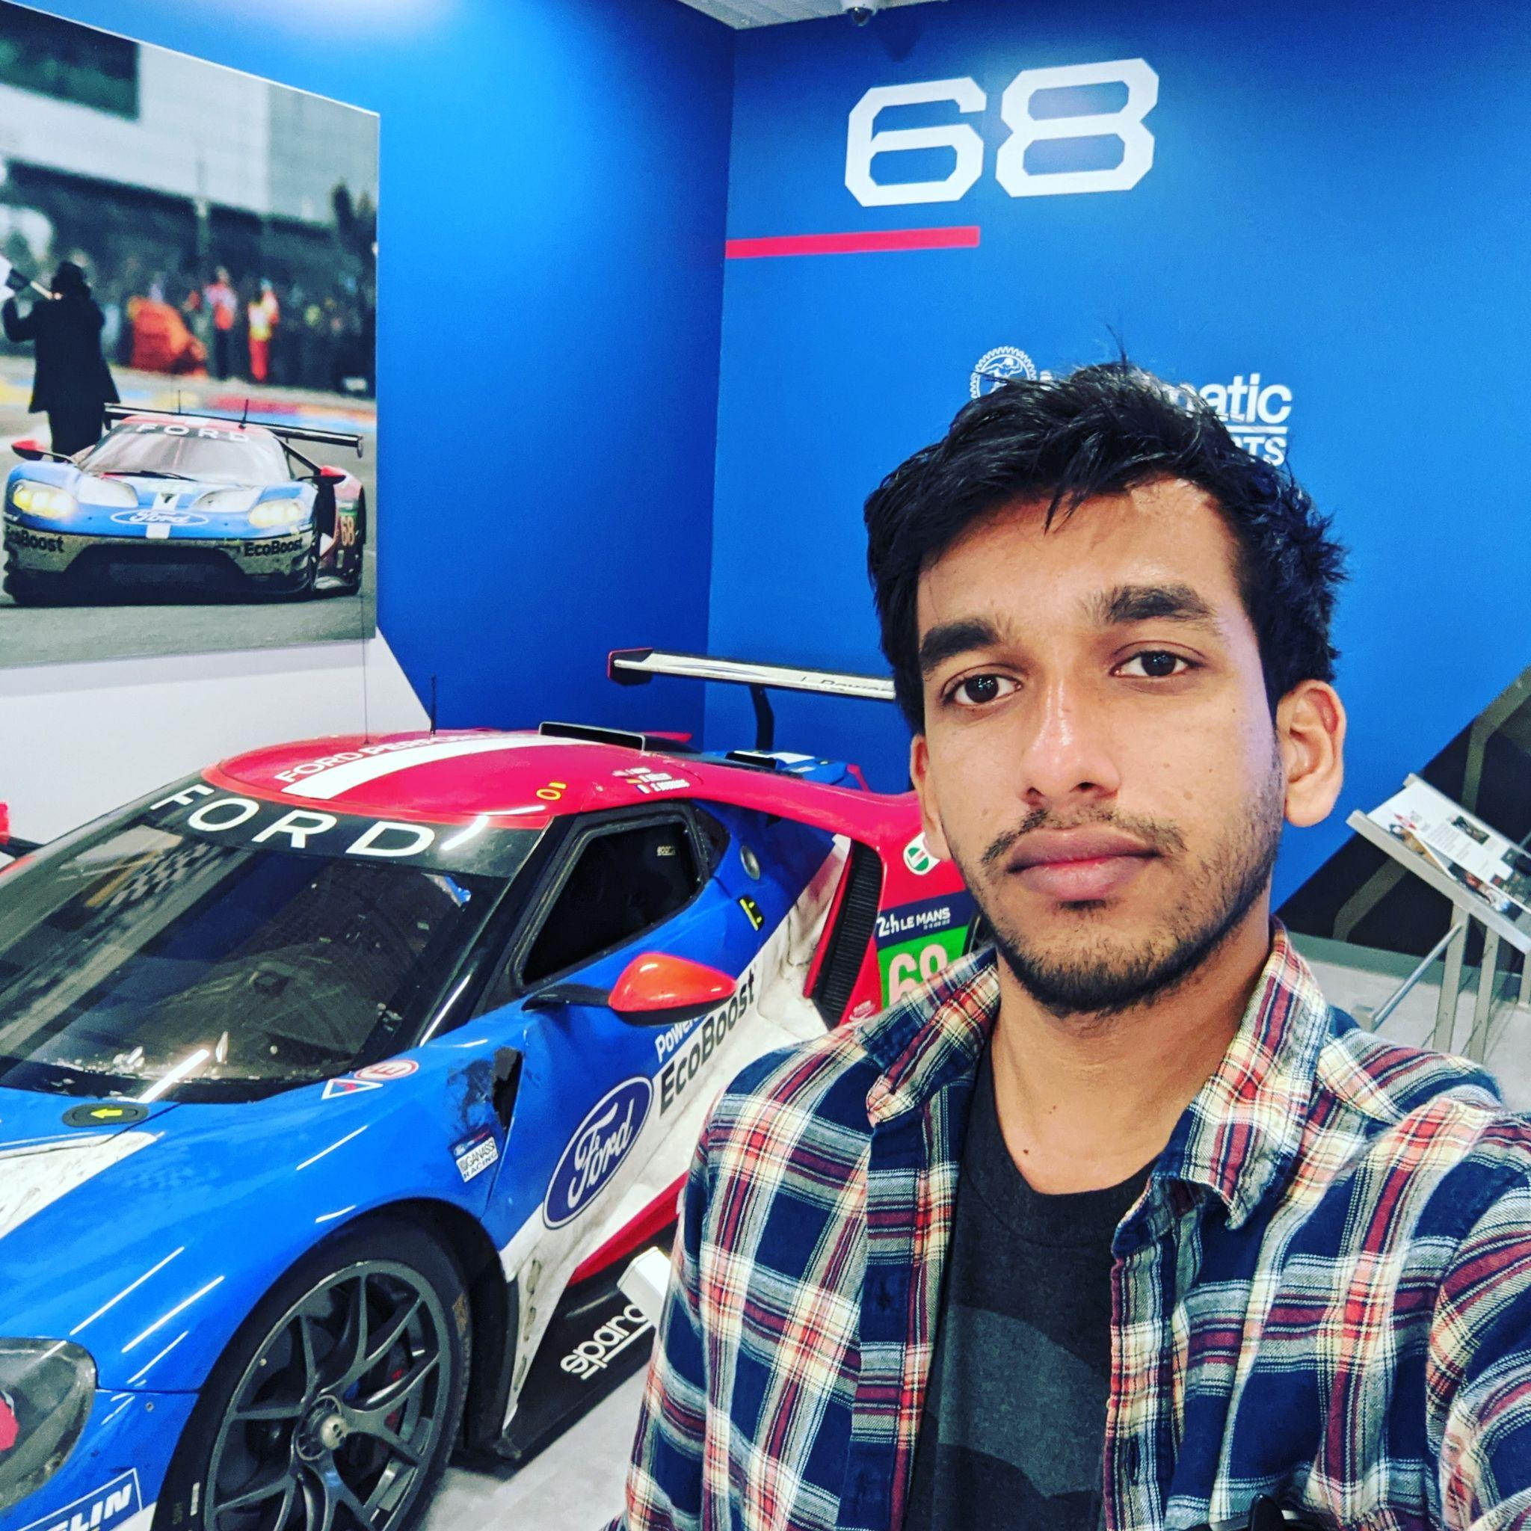
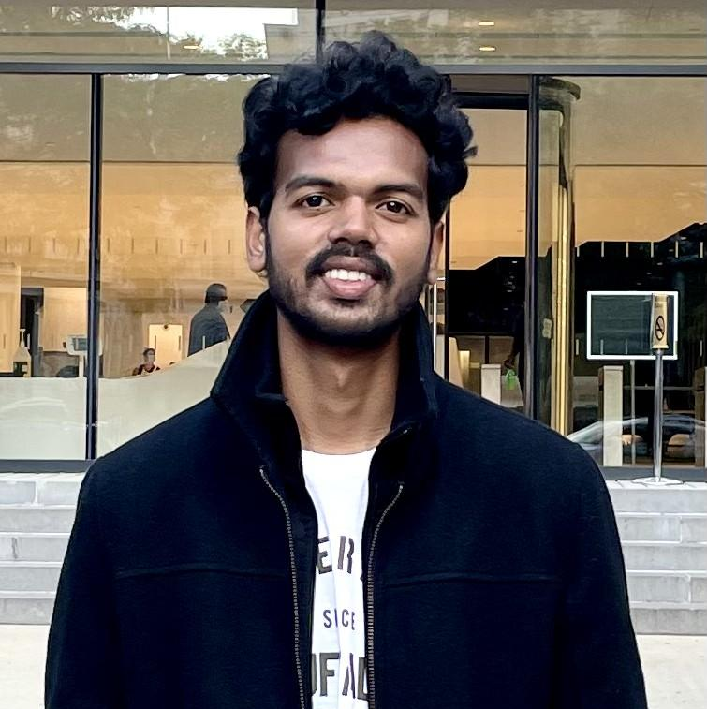
TEAM MEMBERS
ROLES & RESPONSIBILITIES
Aakansha Agarwala: Project Manager/Scrum Master
1. Led team meetings and kept the team on task
2. Maintains the project’s GitHub repository and Wiki
3. Documented test cases and co-authored technical paper
Nicholas Wong: Machine Learning Engineer
1. Design Computer Vision Model Architecture
2. Train and Evaluate Model Performance
3. Gather representative image data for training
Austin Blaise: Cloud Engineer
1. Contribute to the architecture of the project
2. Creates Infrastructure as code
3. Integrated features and services
Rajat Nagavkar: Ios Developer
1. Design and Development of Application.
2. Integrating ML model to provide specified results.
3. Testing the app to provide a better user experience.
Suryadeep Nallana: FullStack Developer/Quality Analyst
1. Contribution to design and development of the app layout
2. Authored technical document of the project
3. Working towards making our app user-friendly

Slide 4

PROJECT OVERVIEW

Slide 5

PROBLEM STATEMENT
As the population is increasing the amount of waste produced is also increasing.
The world produces 2.01 billion tons of urban solid waste yearly, with the United States being the highest producer of waste.
Most of the waste produced remains unprocessed due to a lack of recycling knowledge.
Squander app overcomes this problem by providing a way for waste recycling through a machine learning platform.

Slide 6
PROJECT DESCRIPTION
Squander app provides a complete solution to organize and plan the disposal of waste. It uses a machine learning algorithm to detect recyclable waste from images and provide proper disposal.
Squander app is an Image-based Waste detection mobile application.
The app works with an image submission by the user and a trained machine learning-based model runs on the image which gives results and information about that image.
As Squander is an image-based application, it’s an easy tool to detect waste by underlying simple steps in the application.
And the application also has a feature that provides the nearest recycling location with an option to schedule a pick of your waste by the recycling factory

Slide 7

PERSONA

Slide 8

Jill, the party host
Background Profile:
Jill, a 32-year-old. He is an event organizer of a well-reputed company in the city. He has organized many big parties and is always busy with his job. He takes all the responsibility and his duties also include providing a good food service. He gets many clients, particularly for the food he provides. His organization is popular among the people Jill does many parties and he collected more food waste by the end of the party. Jill would like to know the waste identified from the image uploaded so that he can confirm the photo he uploaded was processable.
How can Squander help?
Jill being responsible for organizing the party. He wants to recycle all the waste by segregating in rightful manner and help the surrounding environment. He can use an application. Squander which provides his needs by showing the results of nearest recycling company location for all the food waste from his parties that happen wherever in the city. Squander makes an efficient and easiest way in someone’s life like Jill’s

Slide 9
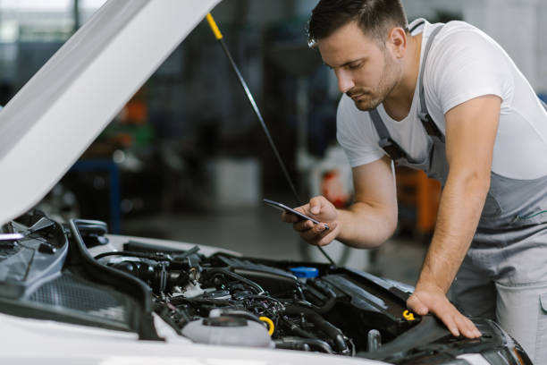
Simon, the mechanic
Background Profile:
Simon is a mechanic for ten years. His age is of 35 years. His jobs is to inspect and repair vehicles, machinery, and light trucks. And he is known for his good service providing for his customers. He works in an indoor garage. Simon’s culminated with metallic waste from his work and he wants to find a recycling location to recycle it and make some money from scrap
How can Squander help?
Simon can use the Squander application that helps him to find the nearest recycling company location for the waste to recycle from the comfort of his garage. This would allow him to find and provide easy access directly to the recycling company. He doesn’t have to worry about the waste and where to recycle it. Through Squander it makes his life easier.

Slide 10

David, the retiree
Background Profile:
David was a sale executive in a marketing firm. He retired from the job recently. He was successful and has been an inspiration for others in the company. After his retirement, David brought up the interest he had for quite some time to renovate his house. He wants to give a personal touch to the house and lead the rest of his life happily in his way. Now he is spending all his time taking care of the process under his supervision and making a beautiful house for himself
How can Squander help?
Squander can be helpful for David, as he is looking after the construction works for his house. The waste can generate a lot, with all the accumulated waste, he can recognize the waste under categories within the app and send it to his nearest garbage station. That’s make David being responsible for his waste and keeping the environment at a better position.

Slide 11

MINIMAL VIABLE PRODUCT

Slide 12
MINIMAL VIABLE PRODUCT (MVP)
Features:
Scheduling the pick up of recycling waste by the factory
Creation of a User Profile for each user who uses the application
Showing the History of a pickup that is scheduled by a user
Showing the recycling statistics for each user

Slide 13

TECHNOLOGIES

Slide 14







TECHNOLOGIES USED
FRONT-END
BACK-END
CLOUD
AWS
Firebase
MapKit API
Notes:
Need help to distinguished all and check if we need to add anything -
Change CloudFormation to just AWS
iOS App - swift, coreML
Backend - python, keras, tensorflow
Apple Map Kit,

Slide 15

ARCHITECTURE DESIGN

Slide 16
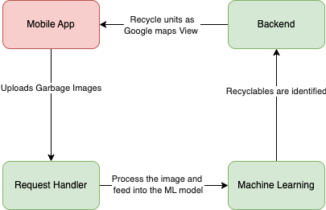
CONCEPTUAL DIAGRAM
Notes:
Need to update it with a sequence diagram and flow diagram - let’s work on changing this,
Conceptual diagram - Austin

Slide 17
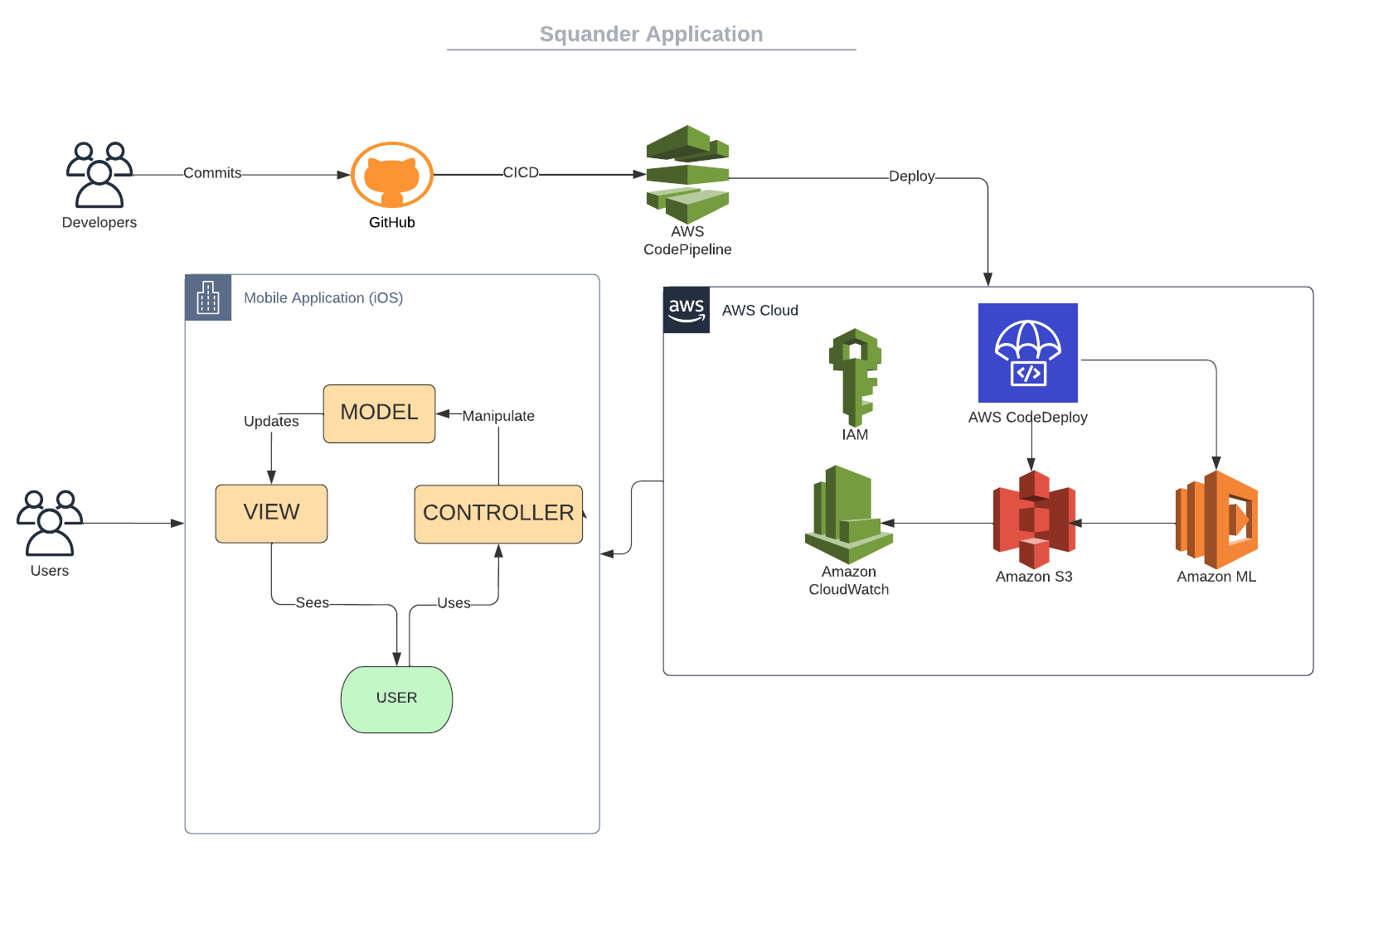
SQUANDER ARCHITECTURE
Notes:
Need to update it with a sequence diagram and flow diagram

Slide 18
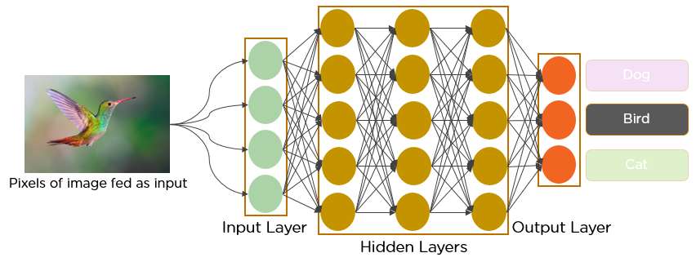
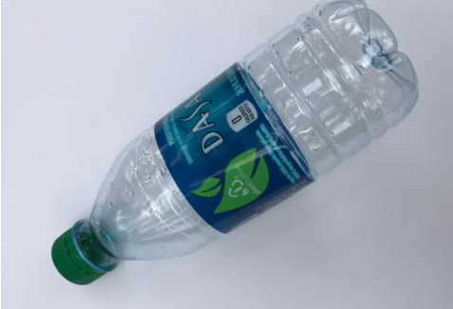
MACHINE LEARNING ALGORITHM
Plastic
Cardboard
Trash

Slide 19
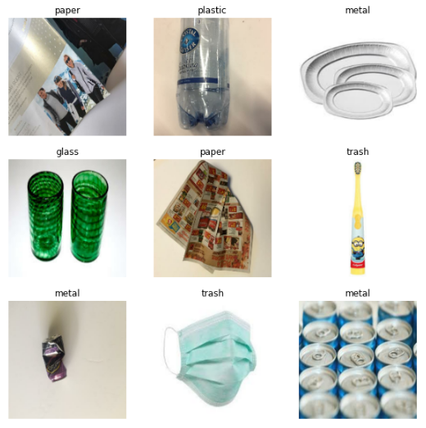
MODEL CLASSIFICATION
The model is able to classify trash into the following categories:
Cardboard
Glass
Metal
Paper
Plastic
Miscellaneous Trash

Slide 20
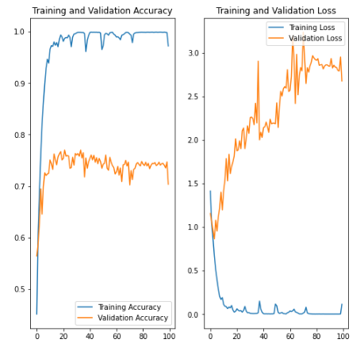
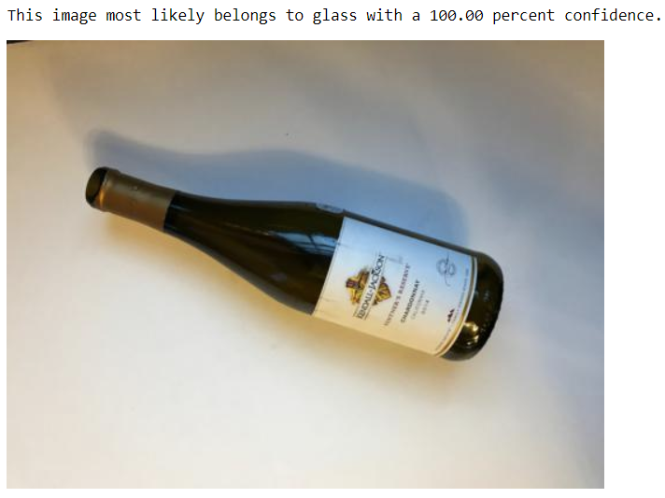
MODEL EVALUATION

Slide 21
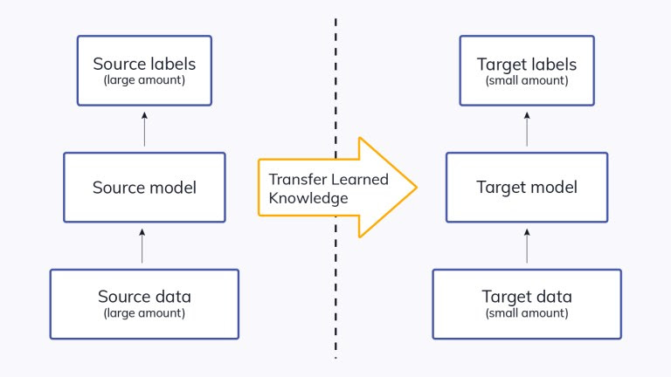
TRANSFER LEARNING
To alleviate the need for more images due to lack of public resources
Leverage a pre - trained model with a large amount of training data.
Fine tune the existing model.

Slide 22
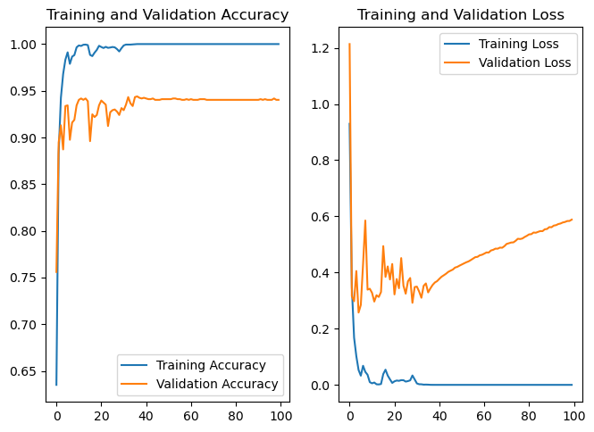
TRANSFER LEARNING RESULTS

Slide 23

SPRINT OVERVIEW

Slide 24
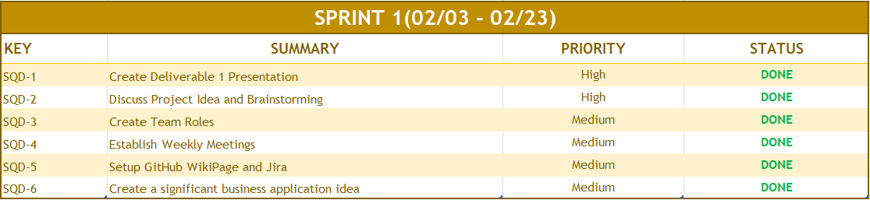
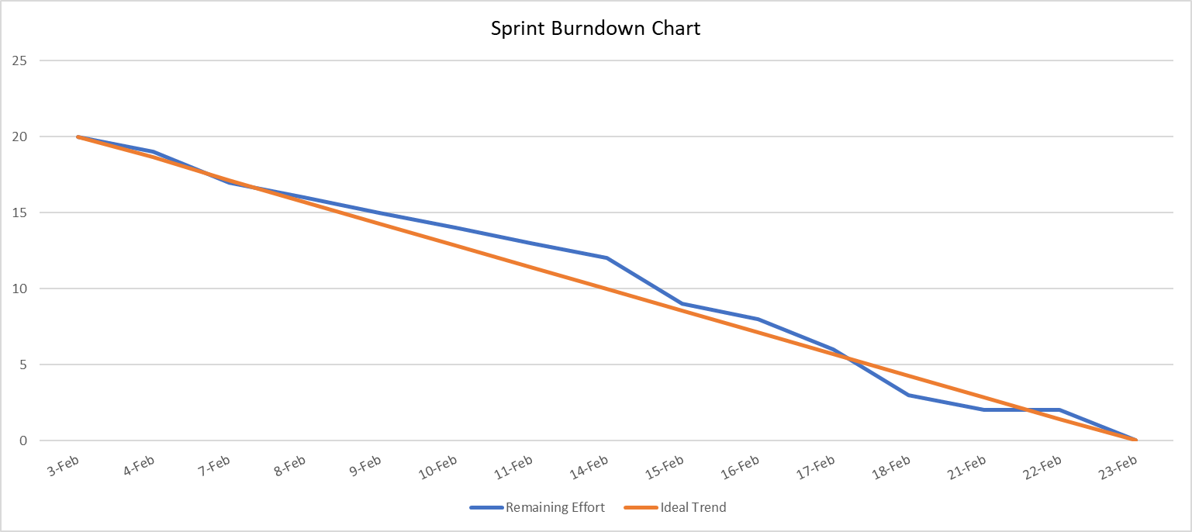
SPRINT I RECAP
Notes:
Need to delete

Slide 25
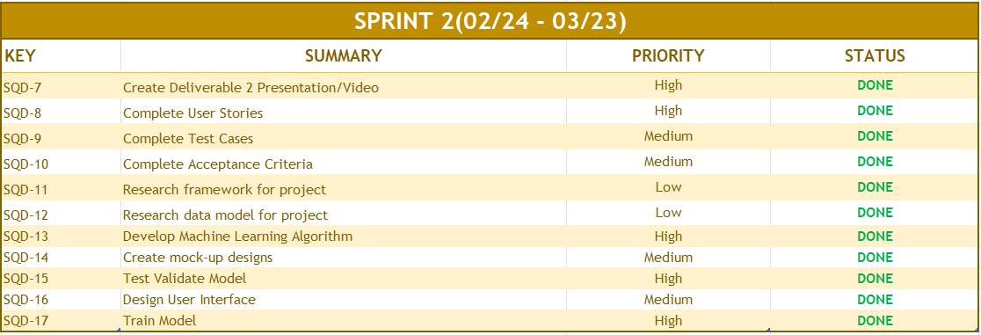
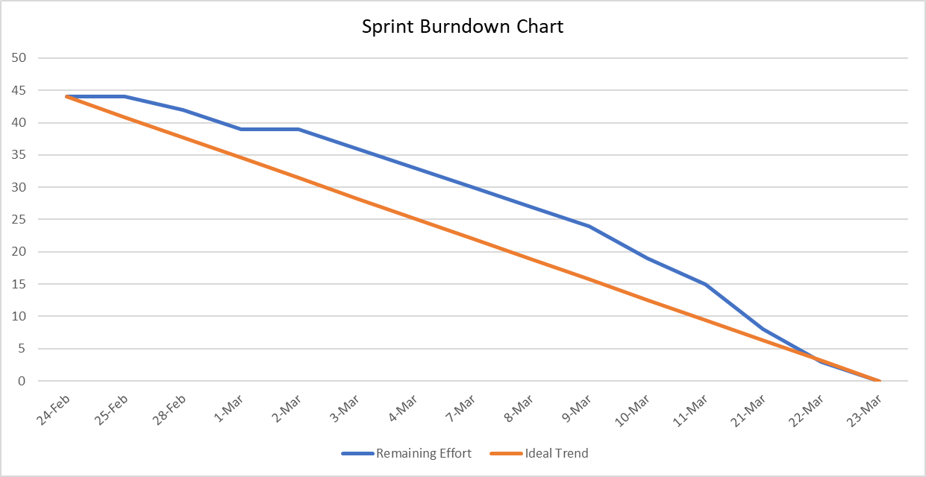
SPRINT II RECAP

Slide 26
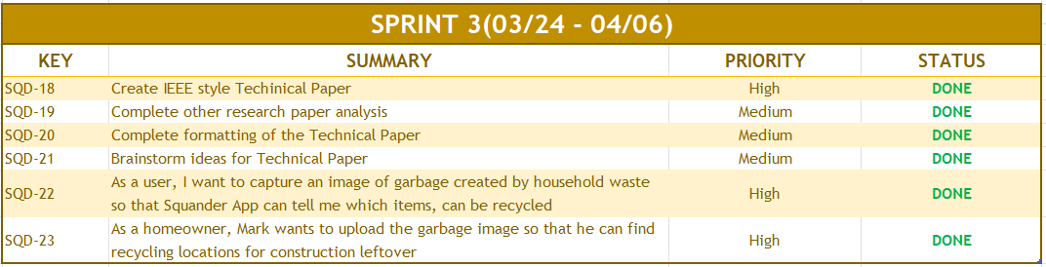
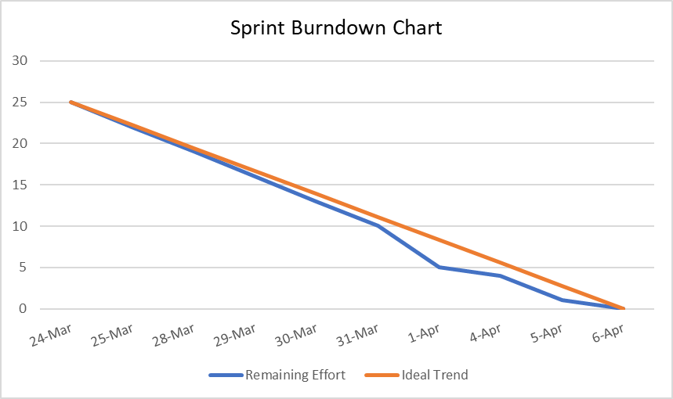
SPRINT III RECAP

Slide 27
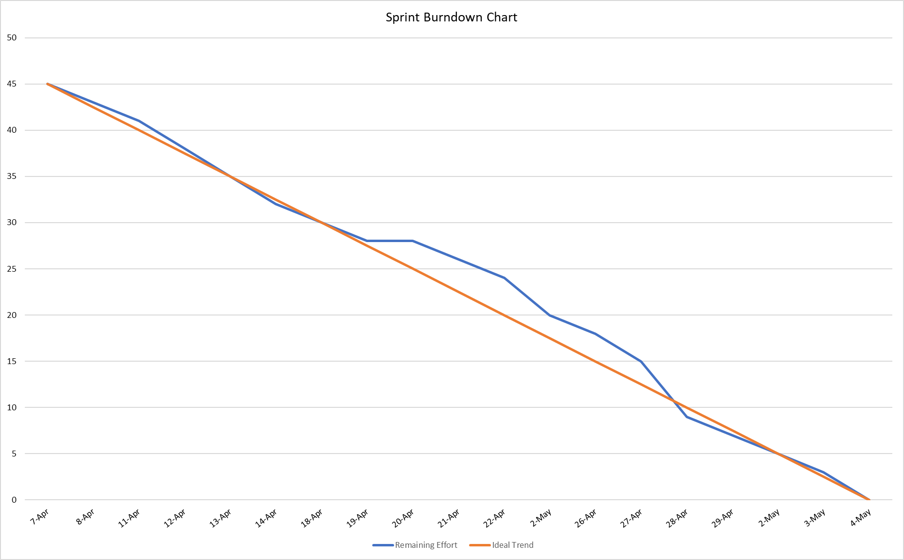
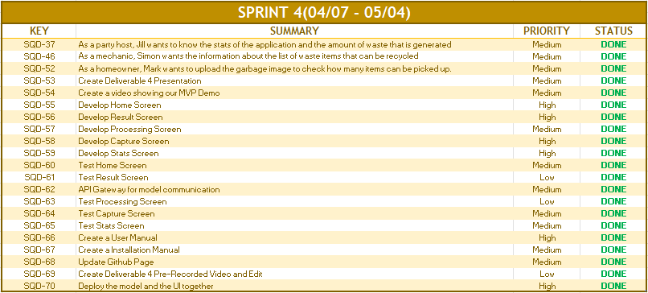
SPRINT IV RECAP
Notes:
Aku will do it

Slide 28

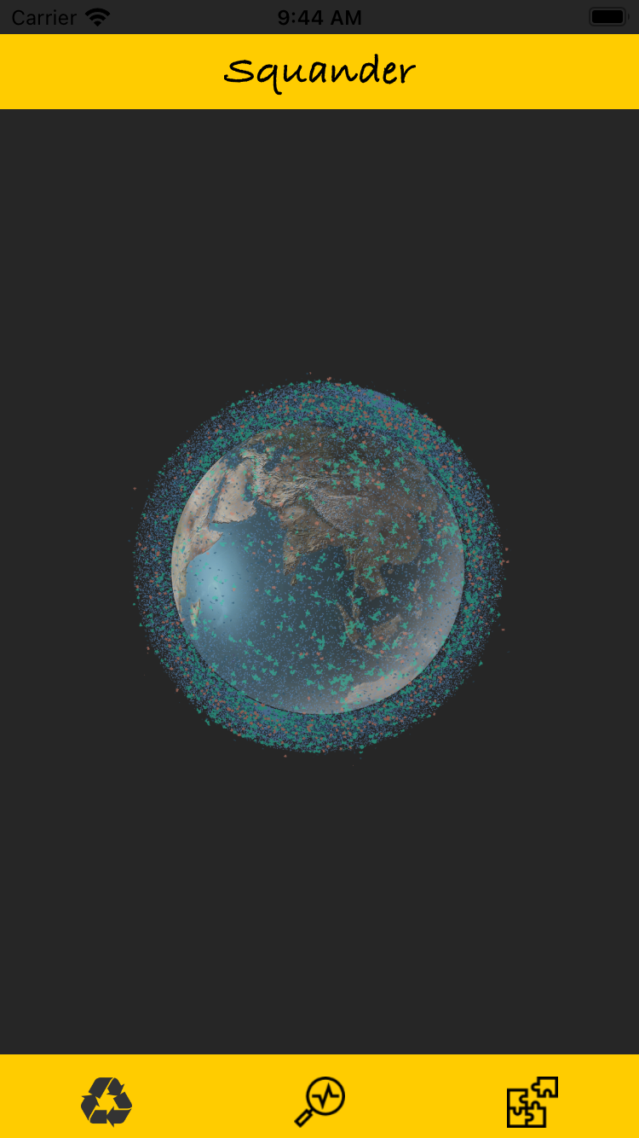
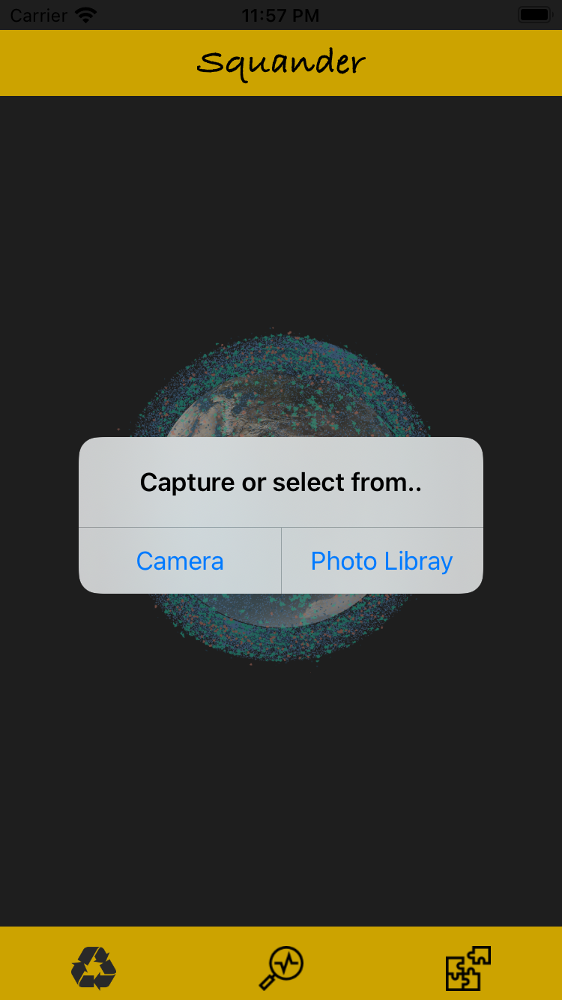
SPRINT IV RECAP (Continued)
Launch Screen
Home Screen
Capture and Select Screen

Slide 29
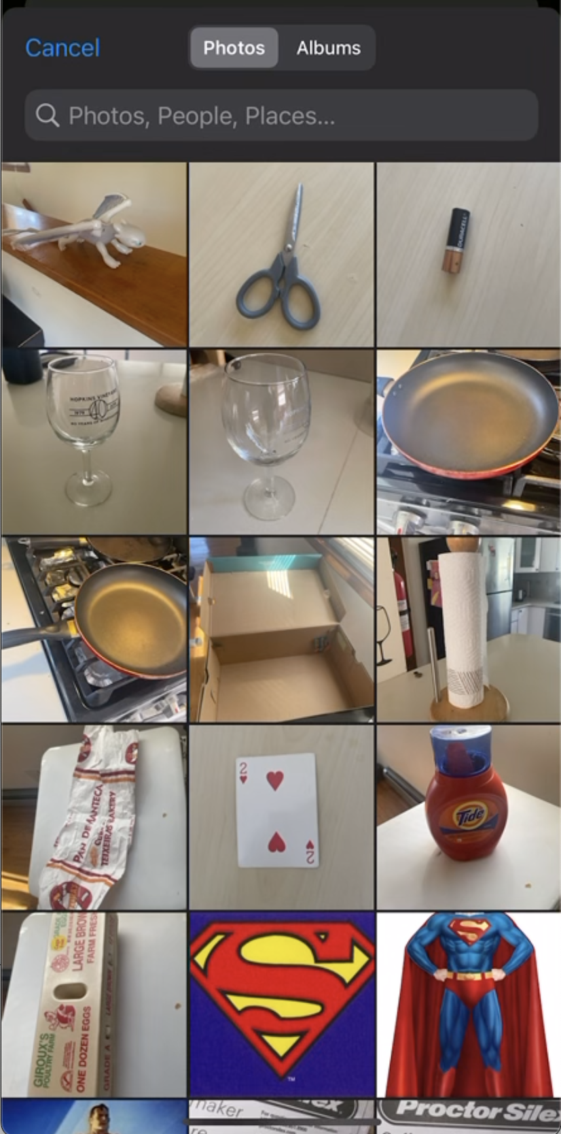
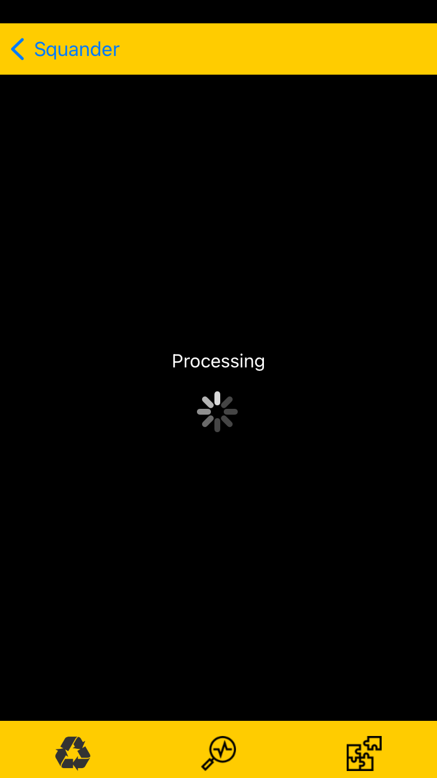
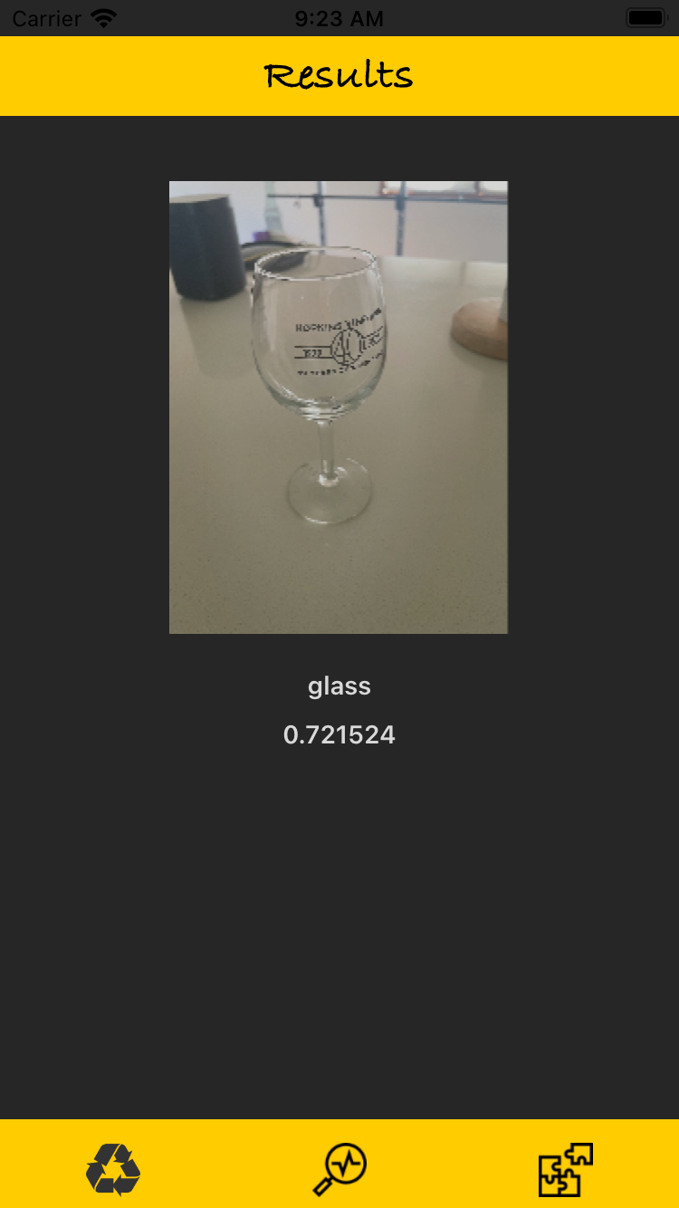
SPRINT IV RECAP (Continued)
Gallery Screen
Processing Screen
Results Screen

Slide 30
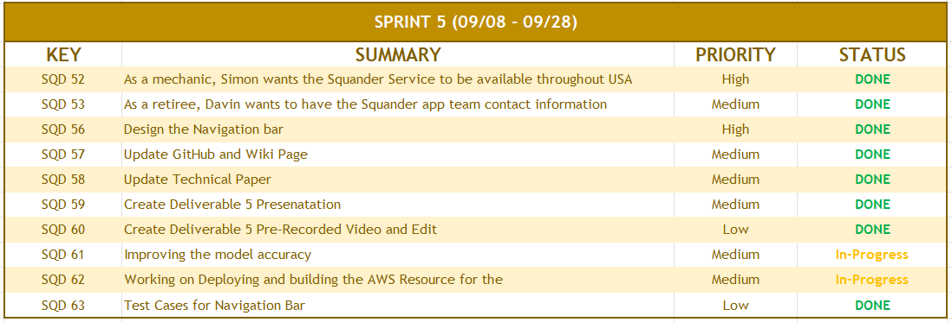
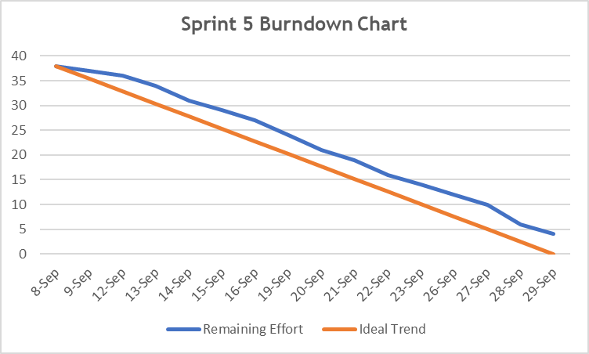
SPRINT V RECAP
Notes:
Look into the ideal trend and fix

Slide 31
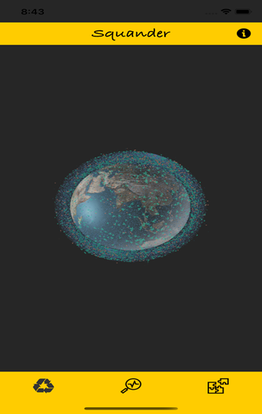
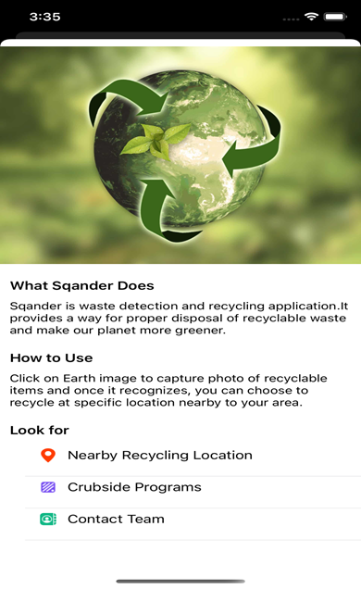
SPRINT V RECAP (Continued)
Home Screen Info button added at the navigation bar
About Screen showing info about the app and recycling guide

Slide 32
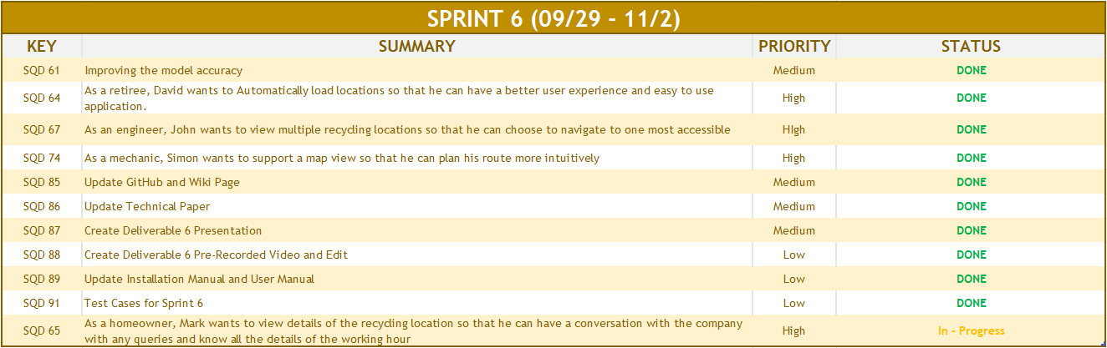
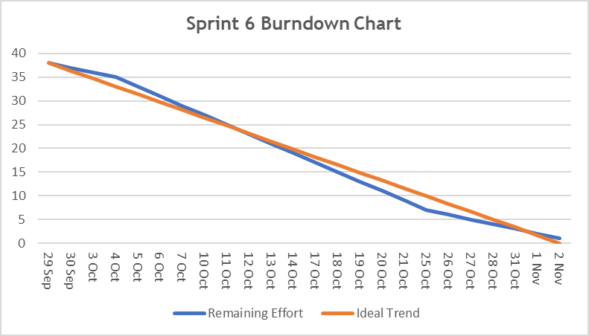
SPRINT VI RECAP

Slide 33
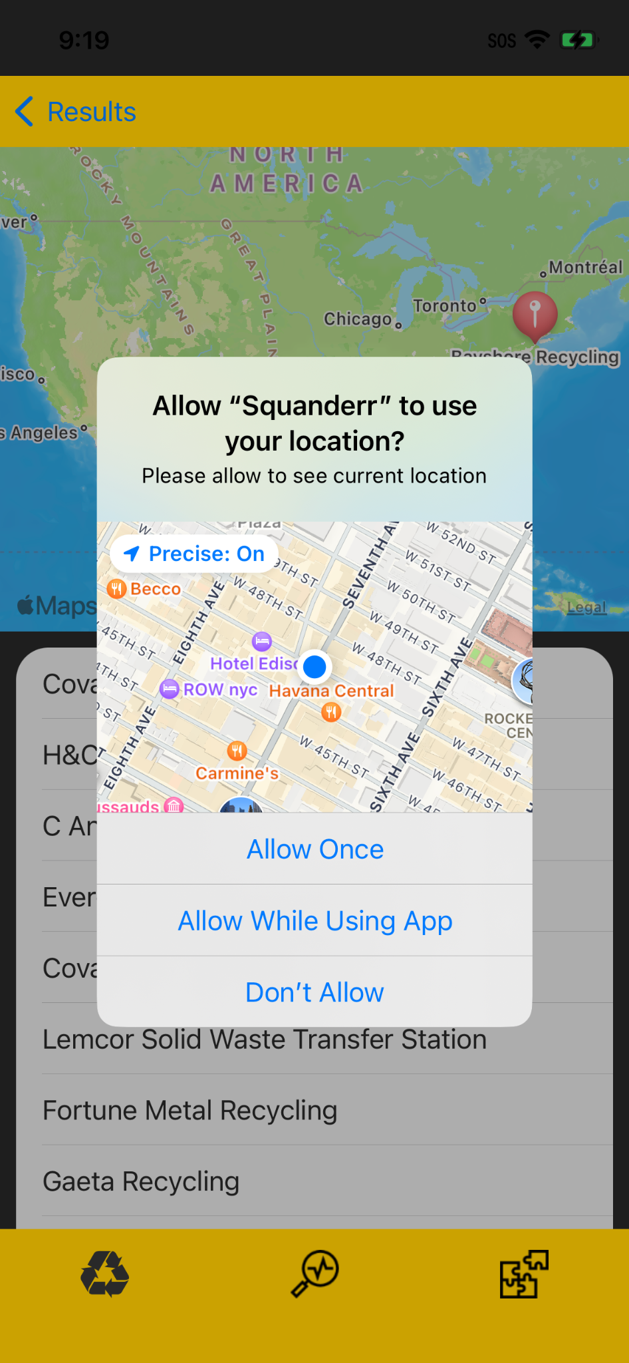
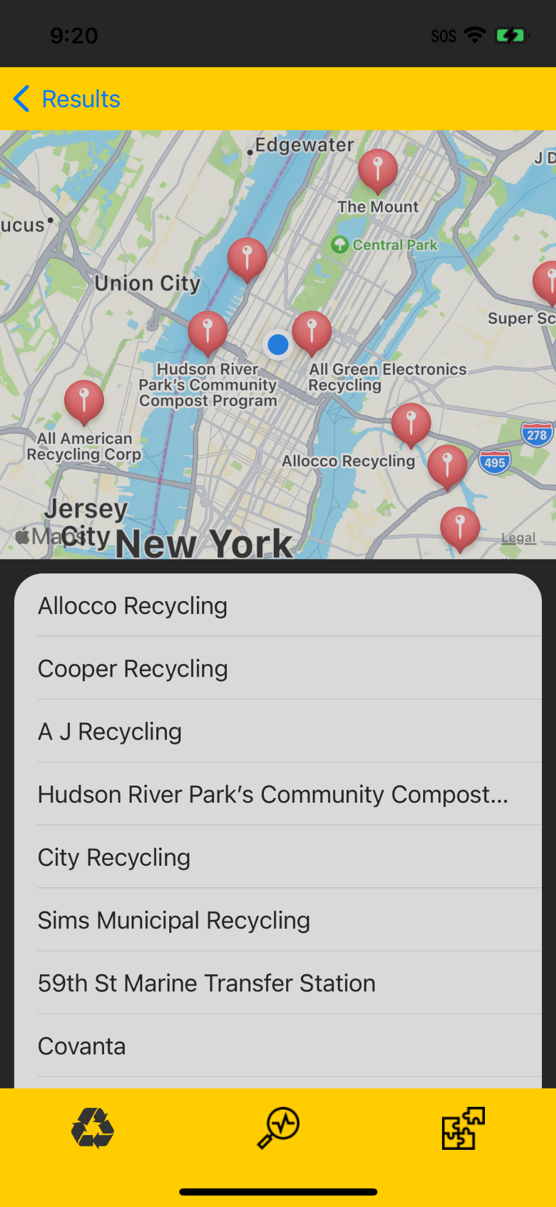
SPRINT VI RECAP (Continued)
Recycling location screen
(Permission to Access User Location)
Recycling location screen..
Showing current Location.
Nearby recycling location.
And list of recycling Company.

Slide 34
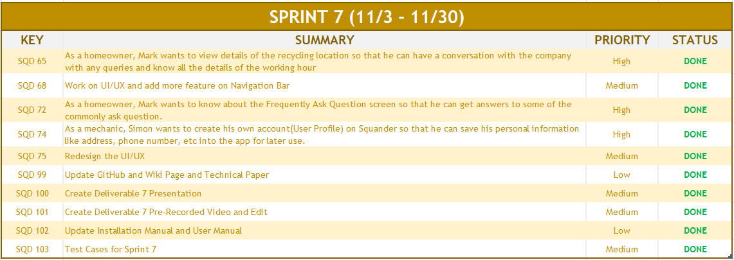
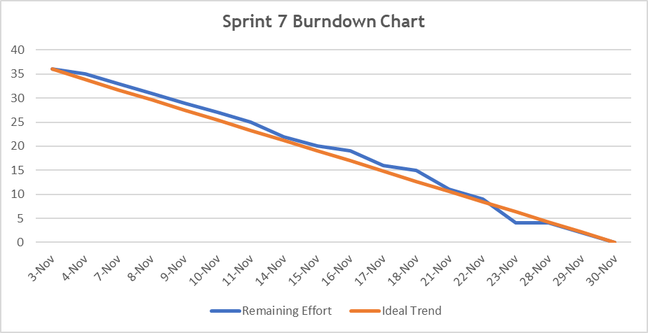
SPRINT VII RECAP
Notes:
Aku will do it

Slide 35
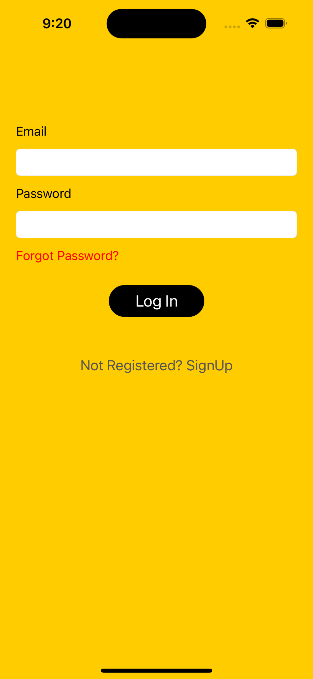
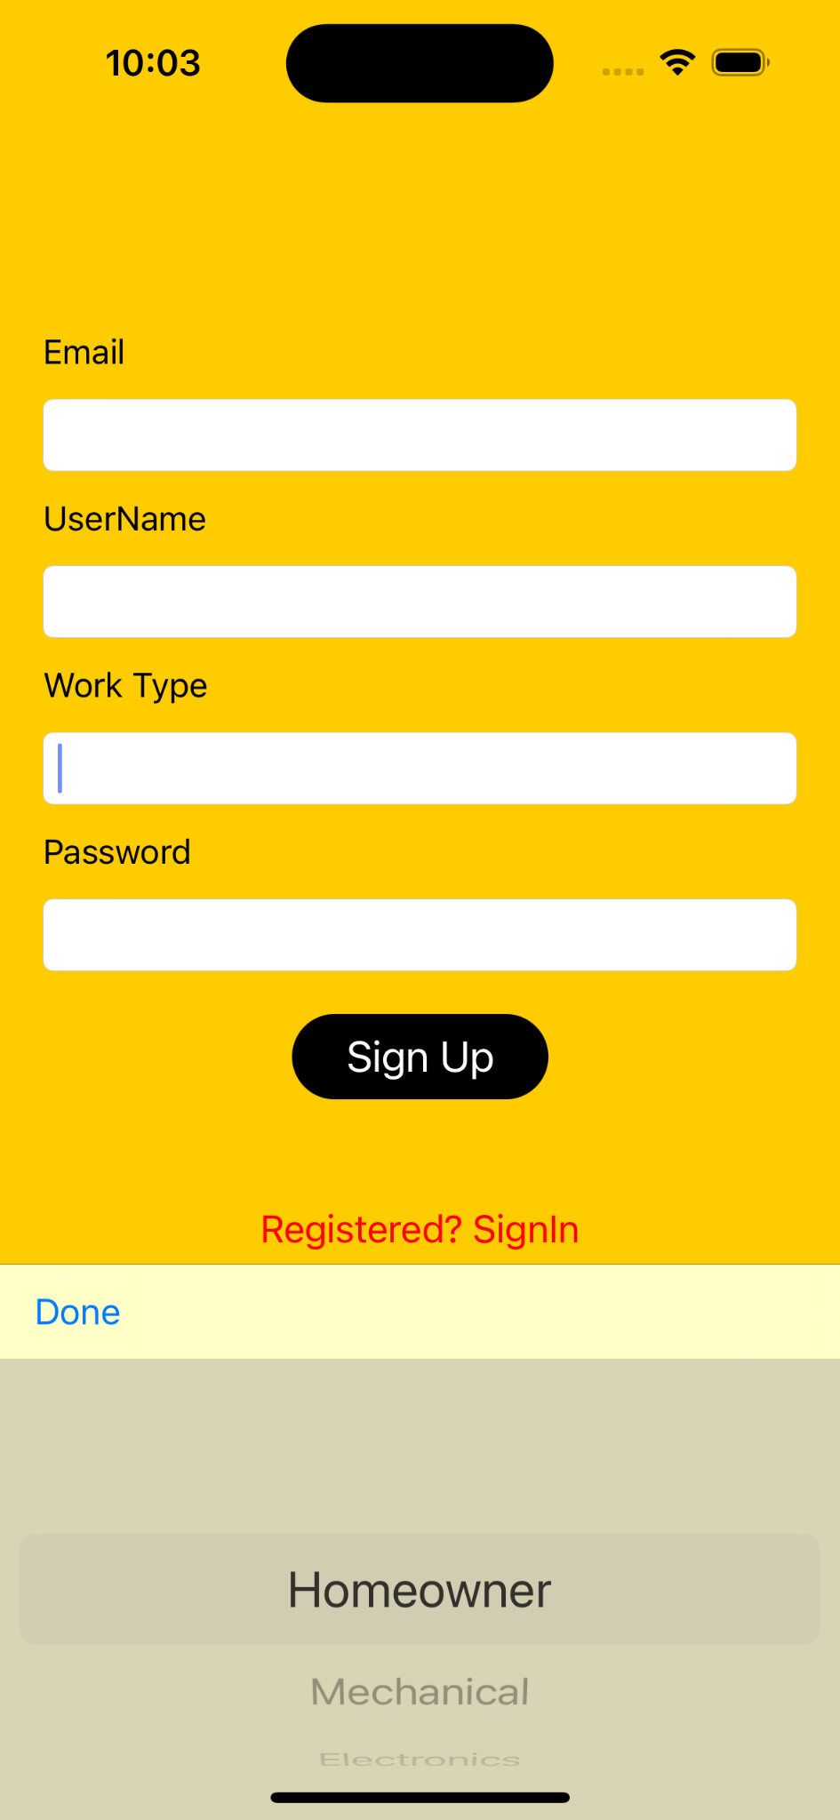
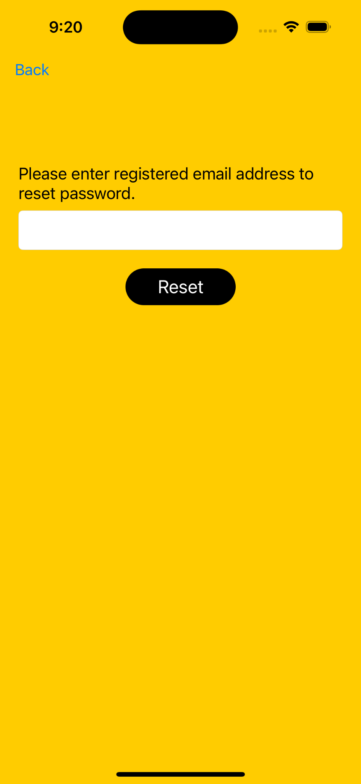
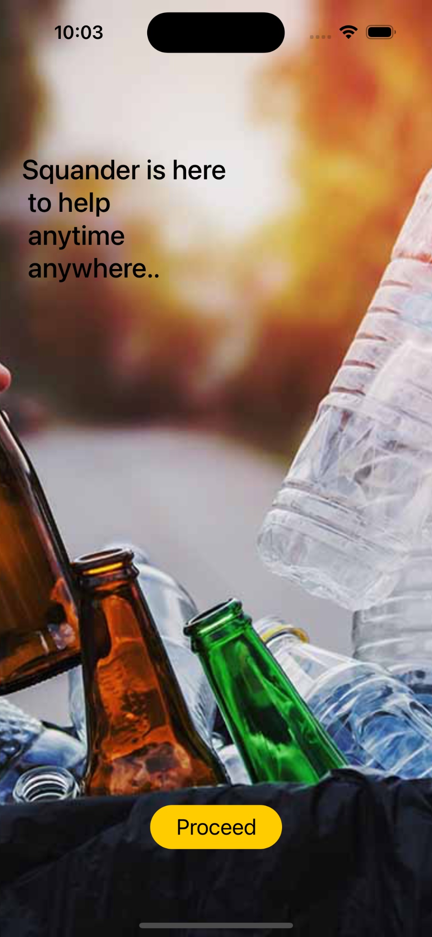
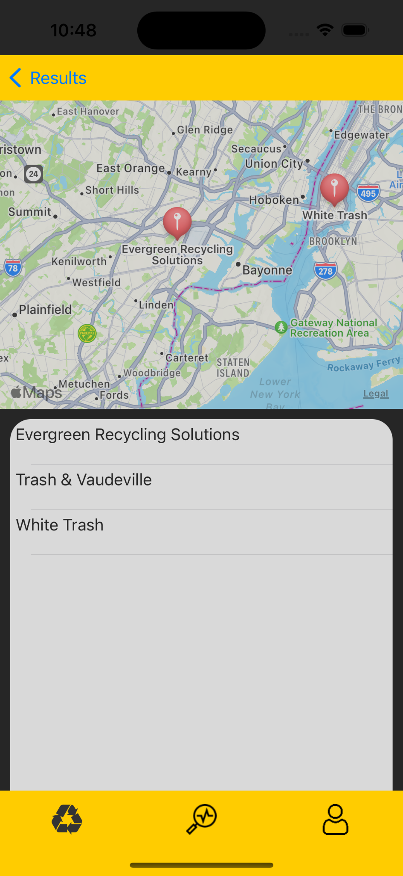
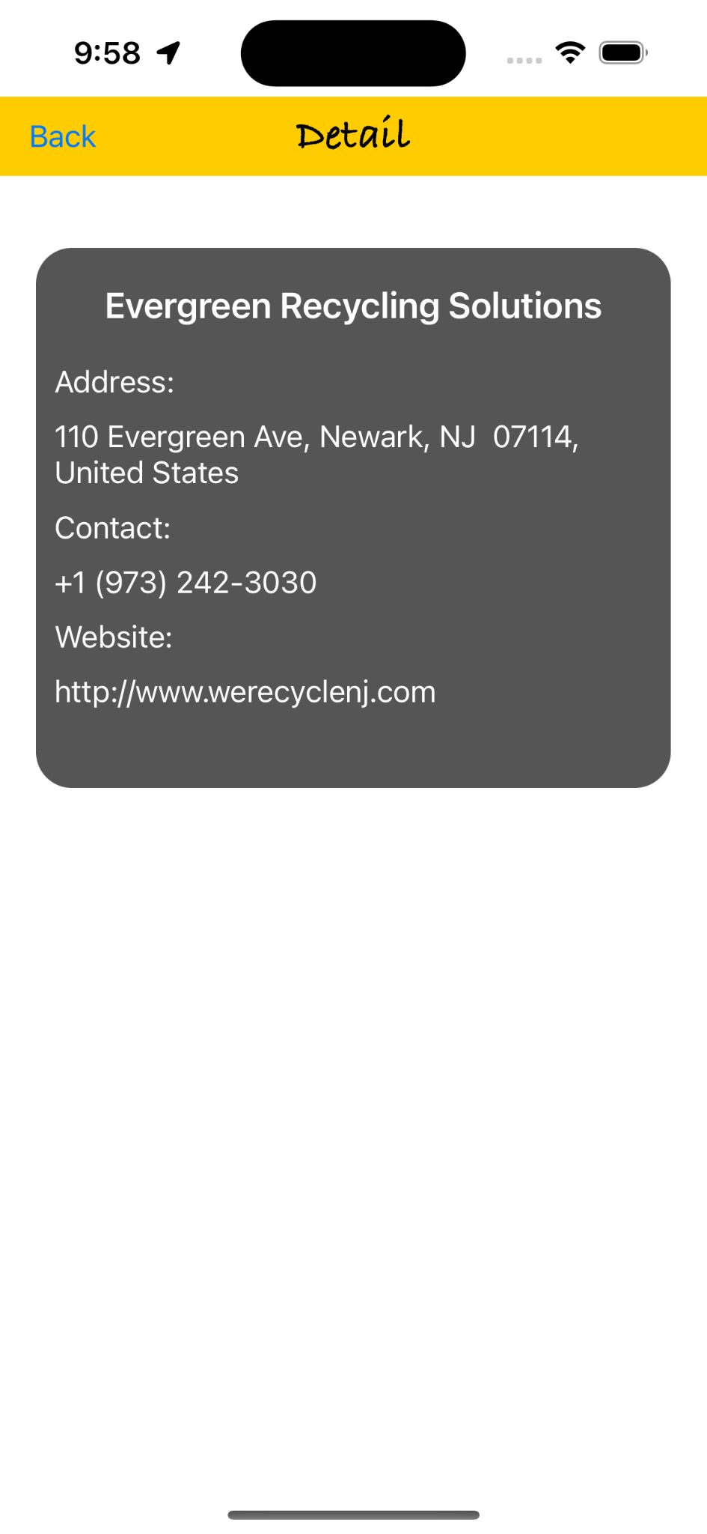
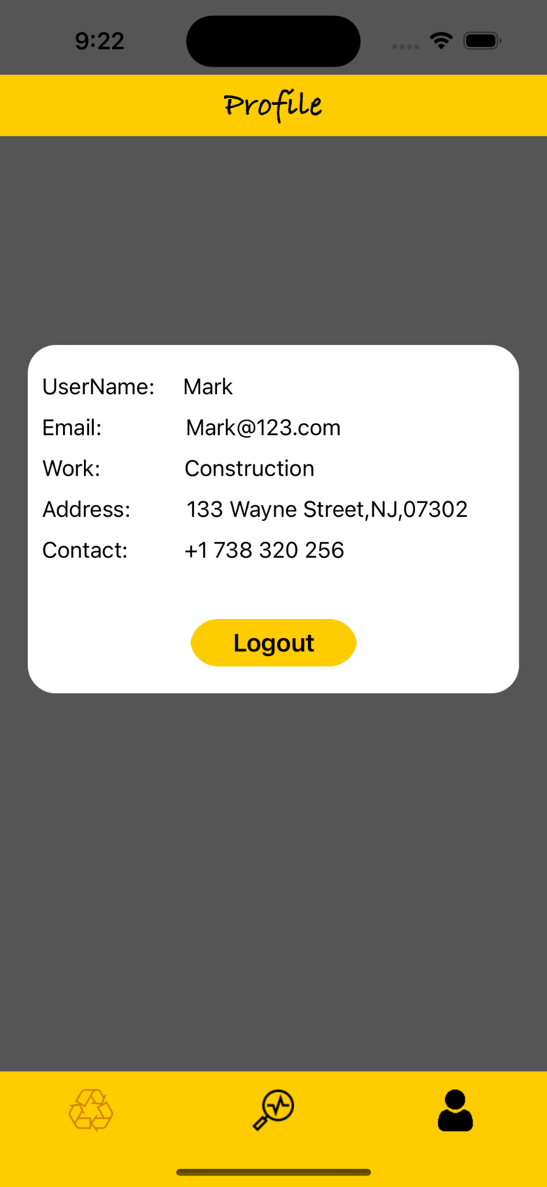
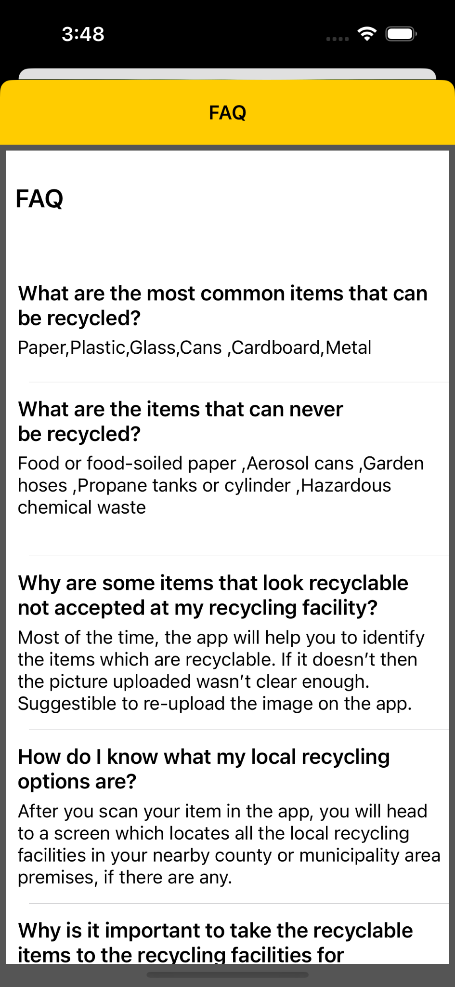
SPRINT VII RECAP (Continued)
Login and Signup:-
For registered user it allows to logIn with username and password.
If it is new user it allows to register via signUp with email, username, worktype, password.
Reset Password and Splash Screen:-
If user wants to reset his password he can type email address so that password reset link is sent.
When a new user opens app for the first time user is navigated to splash Screen.
Once Proceed is clicked user is navigated to login screen.
Detail Screen:-
On the recycling Location Screen user gets list of recycling locations for particular item.
If user clicks on any location then he is navigated to detail screen which shows name, address, contact and website of recycling company.
Profile and FAQ:-
On the profile screen user can see name,email,work address and contact.
FAQ screen shows list of frequently asked questions about how to use app.
Notes:
Aku will do it

Slide 36
SPRINT VII vs SPRINT VIII
SPRINT VII | SPRINT VIII
User Profiling | Request to recycling company
UI/UX | Statistics of Recycling
Multiple entity recognition | User Feedback
FAQ Screen | Integrated ML Model to Application
Notes:
Aku

Slide 37
IMPROVEMENT FROM PROF FEEDBACK
Update the architecture diagram, but including a Conceptual Diagram
Included the Conceptual Diagram (Slide No: 16)
In Burndown Chart, the ideal trend should be smooth
Updated the Burndown Chart making the ideal trend smooth (Slide No:47)
Average velocity should be calculated on completed column and not on ratio column considering all sprint
Updated the Average Velocity(Slide No:48)
Notes:
WhatsApp chat and fill - and update the slide number

Slide 38

BACKLOG

Slide 39
PRODUCT BACKLOG
KEY | SUMMARY | PRIORITY | SPRINT | STATUS
SQD 62 | Working on Deploying and building the AWS Resource for Squander | Medium | Sprint 8 | DONE
SQD 73 | As an engineer, John wants to schedule the pickup with the company so that he can be assured that his trash will be picked up. | High | Sprint 8 | DONE
SQD 76 | As a retiree, David wants to know his recycling statistics so that he can understand his activities with the app | High | Sprint 8 | DONE
SQD 81 | As a retiree, David wants to view team information so that he could provide extended feedbacks. | Medium | Sprint 8 | DONE
SQD 65 | As a homeowner, Mark wants to view details of the recycling location so that he can have a conversation with the company with any queries and know all the details of the working hour | High | Sprint6, Sprint 7 | DONE
SQD 72 | As a homeowner, Mark wants to know about the Frequently Ask Question screen so that he can get answers to some of the commonly ask question. | High | Sprint 7 | DONE
SQD 74 | As a mechanic, Simon wants to create his own account(User Profile) on Squander so that he can save his personal information like address, phone number, etc into the app for later use | High | Sprint 7 | DONE
SQD 64 | As a retiree, David wants to Automatically load locations so that he can have a better user experience and easy to use application. | High | Sprint 6 | DONE
SQD 67 | As an engineer, John wants to view multiple recycling locations so that he can choose to navigate to one most accessible | High | Sprint 6 | DONE
SQD 71 | As a mechanic, Simon wants to support a map view so that he can plan his route more intuitively | Medium | Sprint 6 | DONE
Notes:
Mentions only the user story and mark status as DONE

Slide 40
PRODUCT BACKLOG (Continued)
KEY | SUMMARY | PRIORITY | SPRINT | STATUS
SQD 52 | As a mechanic, Simon wants the Squander Service to be available throughout USA | High | Sprint 5 | DONE
SQD 53 | As a retiree, David wants to have the Squander app team contact information | Medium | Sprint 5 | DONE
SQD 37 | As a party host, Jill wants to know the stats of the application and the amount of waste that is generated | Medium | Sprint 4 | DONE
SQD 46 | As an mechanic, Simon wants the information about the list of waste items that can be recycled | High | Sprint 4 | DONE
SQD 47 | As a homeowner, Mark wants to upload the garbage image to check how many items can be picked up | High | Sprint 4 | DONE
SQD 22 | As a mechanic, Simon wants to capture an image of the garbage created by household waste so that Squander App can tell me which items can be recycled | Medium | Sprint 3 | DONE
SQD 65 | As a homeowner, Mark wants to upload the garbage image so that he can find recycling locations for construction leftover | High | Sprint 3 | DONE
Notes:
Mentions only the user story and mark status as DONE

Slide 41
SPRINT BACKLOG
SPRINT 8 (12/1 - 12/20)
KEY | SUMMARY | PRIORITY | STATUS
SQD 73 | As an engineer, John wants to schedule the pickup with the company so that he can be assured that his trash will be picked up. | High | DONE
SQD 76 | As a retiree, David wants to know his recycling statistics so that he can understand his activities with the app | High | DONE
SQD 81 | As a retiree, David wants to view team information so that he could provide extended feedbacks. | Medium | DONE
SQD 62 | Working on Deploying and building the AWS Resource for Squander | Low | DONE
SQD 124 | Integrated the ML Model to the Squander Application | High | DONE
SQD 125 | Update GitHub and Wiki Page and Technical Paper | Medium | DONE
SQD 126 | Create Deliverable 8 Presentation | Medium | DONE
SQD 127 | Create Deliverable 8 Pre-Recorded Video and Edit | Medium | DONE
SQD 128 | Update Installation Manual and User Manual | Low | DONE
SQD 129 | Test Cases for Sprint 8 | Medium | DONE

Slide 42
USER STORIES & ACCEPTANCE CRITERIA
ID | AS A | I WANT TO | SO THAT | ACCEPTANCE CRITERIA
SQD 73 | John, engineer | Request for a pickup | He could get his trashed picked up | Given: John chooses to schedule a pickup , When: request a recycling pickup, Then: get a promise on his trash pickup scheduled.
SQD 76 | David, retire | View statistics of recycling | He can understand his activities with the app | Given: David like to know his usage statistics When: opening the stats page Then: able to view a representation of his activities.
SQD 81 | David, retire | View team information | He could provide extended feedbacks | Given: David visits the team information When: he clicks on the contact team, Then: able to view enough details to provide feedbacks in app.

Slide 43

TEST CASES

Slide 44
TEST CASES
Test Case Name | User Story | Test Case ID | Test Action | Expected Results | Test Result | Pass/Fail
User Feedback | SQD-81 | SQD-130 | Locate the Contact Team Icon on the Nav Bar | User should be able to locate the Contact Team icon on the Nav Bar | User is able to locate the Contact Team icon on the Nav Bar | PASS
 |  | SQD-131 | Click on the Contact Team icon | User should be able to see the Contact Team icon on the Nav Bar and it should be clickable | Once the user click on the Contact Team icon and its is clickable and taking to a new screen | PASS
 |  | SQD-132 | Locate Contact team email | User should be able to see the Squander Contact Team email address | One the user is on the Contact Team screen, they are able to see the email address | PASS
 |  | SQD-133 | Locate Contact Team Phone Number | User should be able to see the Squander Contact Team phone number | One the user is on the Contact Team screen, they are able to see the phone number | PASS
 |  | SQD-134 | Locate Feedback Request Button | User should be able to see the User Feedback Request Button | Once the user is on the Contact Team Screen, they are able to see the Feedback request button which is clickable | PASS
Recycling Statistics | SQD-76 | SQD-135 | Locate the Stats icon on the Nav Bar | User should be able to locate the Stats icon on the Nav Bar | User is able to locate the Stats icon on the Nav Bar | PASS
 |  | SQD-136 | Stats of recycle item visible | User should be able to see the Stats of all the item they have recycled | Once the user is on the Stats Screen they are able to see their Stats of recycled items | PASS
 |  | SQD-137 | Detailed view of Stats with company name, date & item | User should be able to see the details of the recycling company they have used to recycle a item along with date | Once the user is on the Stats Screen, they are able to see the recycling company name along with the particular items they have recycled along with the date they have done. | PASS
Notes:
Aku

Slide 45
TEST CASES (Continued)
Test Case Name | User Story | Test Case ID | Test Action | Expected Results | Test Result | Pass/Fail
Request Pickup Scheduling | SQD-73 | SQD-138 | Locate the Recycling Company Detail Button | User should be able to see the Recycling company Detail Button and it is clickable. | Once the user is on the Recycling company list along with the Detail Button which is clickable | PASS
 |  | SQD-139 | View the Recycling Company Details | User should be able to view the details of the recycling company | Once the user is on the recycling page and it click on a company it will pop the details of the company. | PASS
 |  | SQD-140 | Locate the Contact Button | User should be able to see the Contact Button and its should be clickable | One the user is on the Detail Screen,they can see a contact button and it is clickable | PASS
 |  | SQD-141 | Locate company address, phone no, & website | User should be able to view the recycling company address, phone number & website | Once the user is on the Detail Screen, they are able to view the recycling company address, phone no & website | PASS
 |  | SQD-142 | Click on the Contact Button | User should be able to click on the Contact Button and a new Request screen should pop up | Once the user click on the Contact Button a new Request Screen open up | PASS
 |  | SQD-143 | Locate the Request Screen | User should be able to see the Request screen with the waste image | One the user clicks on Contact Button a Request screen is visible with waste image | PASS
 |  | SQD-144 | View Description Text Box | User should be able to view the Description text where we can enter our details upto 1000 characters | Once the user is on the Request Screen, a Description Text Box is visible and where we can enter upto 1000 characters. | PASS
 |  | SQD-145 | Locate Request Button | User should be able to view the Request Button | Once the user is on the request screen, a request button is visible | PASS
 |  | SQD146 | View Request Alert | Once the user click on the request button, a request should be sent to the company and an alert should be shown | Once the user click on the request button, a request is sent to recycling company and an alert is shown to user stating the same. | PASS
Notes:
Aku

Slide 46
STORIES COMPLETED
ID | AS A | I WANT TO | SO THAT | ACCEPTANCE CRITERIA
SQD 73 | John, engineer | Request for a pickup | He could get his trashed picked up | Given: John chooses to schedule a pickup , When: request a recycling pickup, Then: get a promise on his trash pickup scheduled.
SQD 76 | David, retire | View statistics of recycling | He can understand his activities with the app | Given: David like to know his usage statistics When: opening the stats page Then: able to view a representation of his activities.
SQD 81 | David, retire | View team information | He could provide extended feedbacks | Given: David visits the team information When: he clicks on the contact team, Then: able to view enough details to provide feedbacks in app.

Slide 47
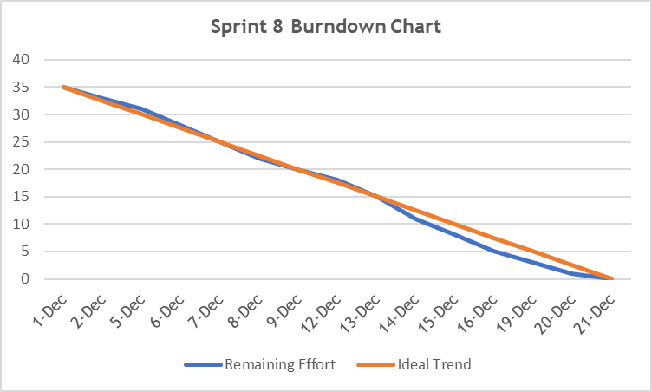
BURNDOWN CHART
Notes:
Burn down chart need to be straight line for ideal trend

Slide 48
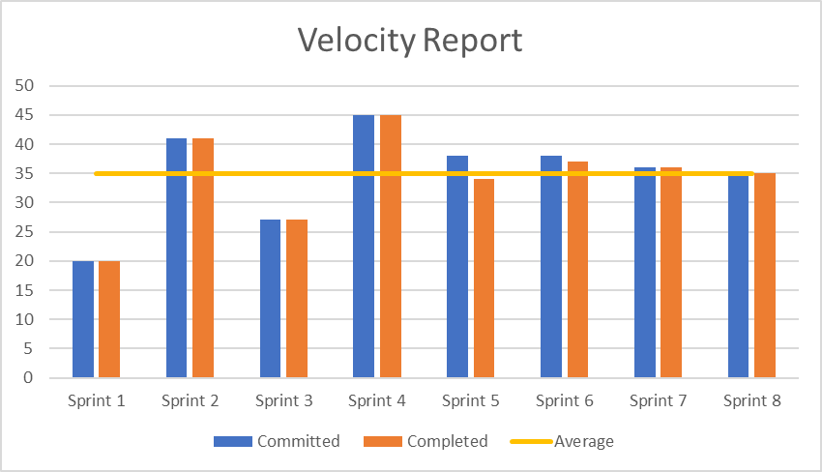
TEAM VELOCITY
Average Velocity
= (20 + 41 + 27 + 45 + 34 + 37 + 36 + 35)/8
= 35
Notes:
Average velocity = Total completed / 8

Slide 49
COMMITTED/COMPLETED RATIO
SPRINT | Committed | Completed | Ratio (%)
Sprint 1 | 20 | 20 | 100
Sprint 2 | 41 | 41 | 100
Sprint 3 | 27 | 27 | 100
Sprint 4 | 45 | 45 | 100
Sprint 5 | 38 | 34 | 89.47
Sprint 6 | 38 | 37 | 97.37
Sprint 7 | 36 | 36 | 100
Sprint 8 | 35 | 35 | 100
Average Committed Completed Ratio = 99%
Current Committed Completed Ratio (Sprint 8) = 100%
Notes:
Average velocity = Total completed / 8

Slide 50

RETROSPECTIVE

Slide 51
RETROSPECTIVE
01
What went well
Team involvement.
Kept proper track of tasks for each team member.
02
What needs improvement
Implementing daily scrum principles
Allocate some time for knowledge sharing.
03
Future Actions
Implementing daily scrum principles.
Interactive activities to improve team engagement.

Slide 52

FUTURE SPRINT

Slide 53
FUTURE SPRINT
Implement more classes for recognition
Create and register domain name for application
Implement load balancer and network routing in AWS
Develop compatibility across different platforms
Notes:
Implement more classes for recognition
Create and register domain name for application
Implement load balancer and network routing in AWS
Develop compatibility across different platforms

Slide 54
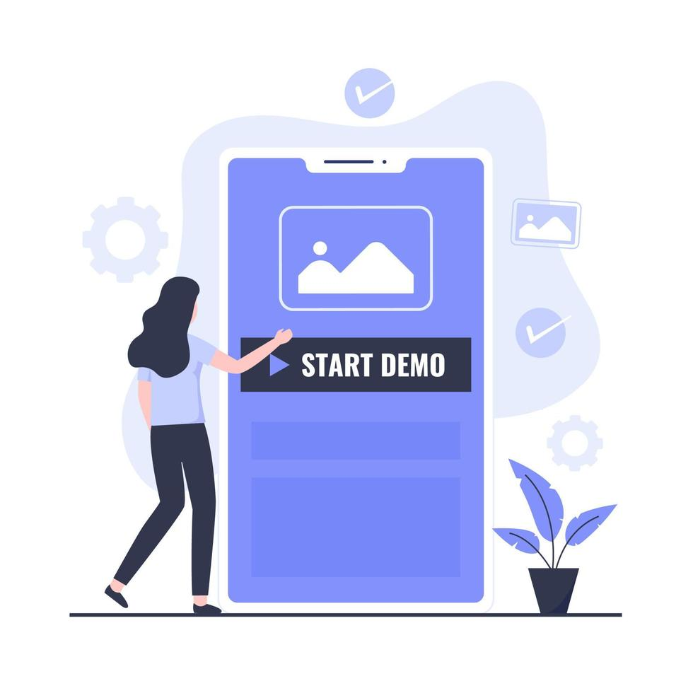
PROJECT DEMO

Slide 55
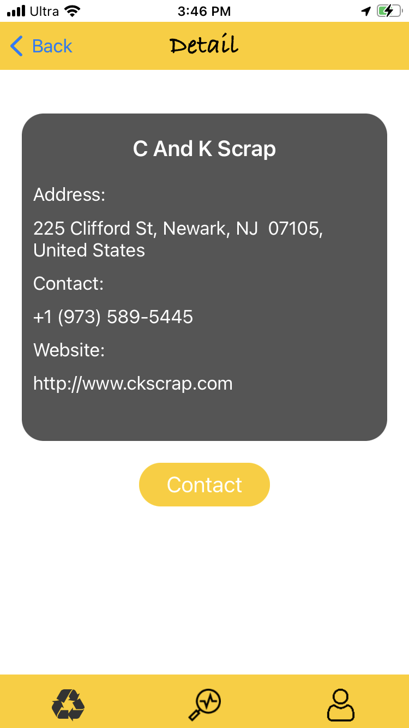

APP SCREENSHOTS
Detail Screen and Request to Recycling.
After selection of recycle location detail Screen is displayed which shows details of recycling location such as address,contact,website address.
On the right is request to recycling location screen which is displayed when user clicks contact button.

Slide 56

APP SCREENSHOTS (Continued)
Request to recycling alert.
In this screen image of item to be recycled, its name is displayed and description about items is entered so that request is setup.
Once request button is clicked user request is sent to recycling location showing alert.

Slide 57


APP SCREENSHOTS (Continued)
Stats Screen and Contact team
Once the request is sent, the recycling location process this request and statistics are displayed on stats screen showing list of all the items a particular user has recycled.
On the right is contact team screen where user can contact squander team and provide feedback about the app and its recycling process.

Slide 58

API
MapKit API
Core Location API

Slide 59

GITHUB LINK
GitHub: https://github.com/anku518/Squander/wiki

Slide 60
THANK YOU!!!

